Slide 1
Analysis of Time Series Data “Annual Swedish Fertility rates” Using R
Sattajit Sutradhar
Instructor: Dr. Tharanga Wickramarachchi
Date:12/07/2017

Slide 2
Introduction
In our analysis we are going to analyze Annual Swedish Fertility rates over the year period 1750-1849.Using training data set and validation data set we are going predict some fertility rates and compare with the actual one’s.
We will select an initial model based on the Training data set and then search the neighborhood for the model that fits the best.
Then we will perform some diagnostic checking, hypothesis testing of the model then make a prediction and compare with the validation data set.

Slide 3
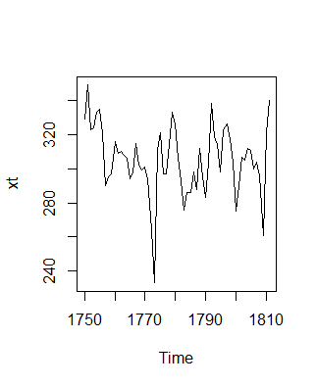
Analysis
Training data set plot
Notes:
As you can see we can’t really find any convincing trend seasonal pattern here .So we went on to look into the ACF and The PACF of the training data set

Slide 4
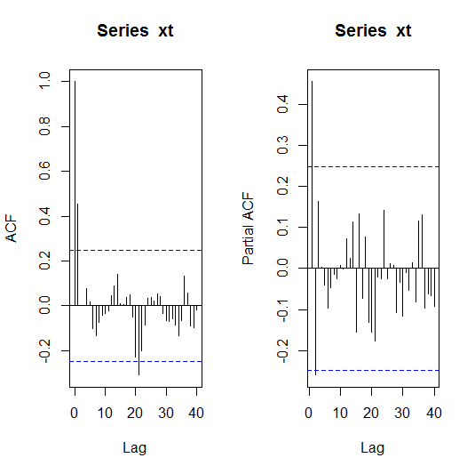
ACF and PACF
ACF
PACF
The ACF and The PACF shows the characteristics of an AR(2) or/and MA(1) model. So the initial guess is ARMA (2,0, 1).

Slide 5
Fitted Model selection
Model | AICc
Arima(2,0,1) | 537.37
Arima(2,0,0) | 535.64
Arima(1,0,0) | 537.61
Arima(0,0,1) | 533.5 (Winner)
Arima(0,0,2) | 535.23
Arima(1,0,1) | 535.38
Arima(1,0,2) | 537.14
Arima(2,0,2) | 539.47
So the winner ARIMA(0,0,1).And our fitted model is Xt=Zt+0.0564Z(t-1)+305.4894

Slide 6
T test for Model Coefficients
Tstat = fit$coef/sqrt(diag(fit$var.coef))
> Tstat
ma1 intercept
6.011045 91.364067
> pval = 2*pt(abs(Tstat), df=60, lower.tail = FALSE)
> pval
ma1 intercept
1.177574e-07 4.142450e-66
Here the p value is very small, the constant term is statistically significant.so we cannot dropped the coefficients from the model.

Slide 7
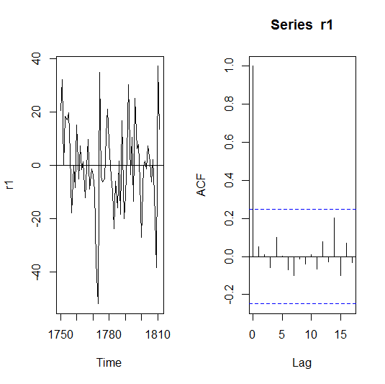
Model Diagnostics
Residual Plot and ACF
The residual plot looks stationary and the ACF shows that the residuals are Uncorrelated.

Slide 8
WN Tests
Box-Ljung test:
> Box.test(r1, lag=20, type="Ljung-Box")
Box-Ljung test
data: r1
X-squared = 9.709, df = 20, p-value = 0.9731
Tests | P-Value
Turning point Test | 0.3591
Rank Test | 0.2663
Shapiro-Wilk normality test | 0.2788
All these p values are greater than .05 indicating it’s a WN.

Slide 9
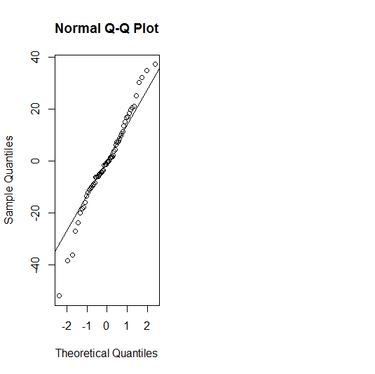
Normal Probability Plot
From the Shapiro-Wilk normality test p value= 0.2788 and the residual plot ,we can say that the residuals are normally distributed.

Slide 10
Forecasting
Our forecasted values closely follow the Actual values

Slide 11
Comparison
Forecasted values with Confidence Interval
Actual Values
Point Forecast Lo 80 Hi 80 Lo 95 Hi 95
1812 313.1026 291.05 335.1476 279.3876 346.8175
305.4894 280.1721 330.8067 266.7699 344.2089
305.4894 280.1721 330.8067 266.7699 344.2089
1815 305.4894 280.1721 330.8067 266.7699 344.2089
1816 305.4894 280.1721 330.8067 266.7699 344.2089
1817 305.4894 280.1721 330.8067 266.7699 344.2089
1818 305.4894 280.1721 330.8067 266.7699 344.2089
1819 305.4894 280.1721 330.8067 266.7699 344.2089
1820 305.4894 280.1721 330.8067 266.7699 344.2089
1821 305.4894 280.1721 330.8067 266.7699 344.2089
1822 305.4894 280.1721 330.8067 266.7699 344.2089
305.4894 280.1721 330.8067 266.7699 344.2089
322
284
297
332
336
317
321
313
311
334
339
349

Slide 12
95%
Forecast and Comparison
80%

Slide 13
Conclusion
From our analysis of the data set ‘Annual Swedish Fertility rate from 1750-1849 We can say that our data set fits the bestwith MA (1).
Forecasting on the validation data set based on the training Data set is reasonably accurate.
Since Our model gives us a reliable prediction for the Annual Fertility rates of Swedish women. So This model can be used
by statistical farms and the government for greater research.

Slide 14
References
[1] Dr. Tharanga Wickramarachchi, Applied Time series and forecasting notes.
[2]Time Series Data LibraryThe Time Series Data Library (TSDL) was created by Rob Hyndman, Professor of Statistics at Monash University, Australia.
[3] Peter J.Brockwell and Richard A.Davis;Introduction to Time series and forecasting ,2nd edition;Springer-Verlag ,NY.

Slide 15
Thanks You For listening.

